Slide 1
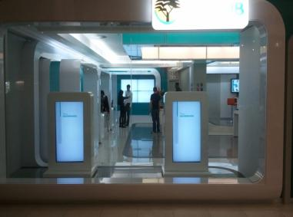
Samsung LFD solution proposal Banks
Pre Sales Support part
Display Marketing Team
Samsung Electronics HQ
[First National Bank , South Africa]
[Ver. 1.0] Last update : 03 Jul, 2012

Slide 2
Challenges
Bring more revenue
Offer Banking Services consulting with a easy explanation.
Create Differentiation and Loyalty
Leave a message of trust us your heritage and future.
Labor costs
High costs with Mkt Material print and Logistics in a country coverage.
Understand customer needs
Really knows their profile as preferences and Services preferred.
Notes:
2

Slide 3
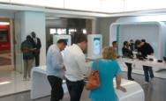
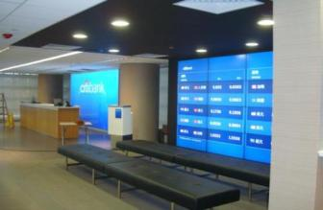
Benefits
Bank
Improve knowledgment
about customers profile.
Create a unique interior design.
Labor costs saved after
to eliminate print billboard
services
Staff training costs
save

Slide 4
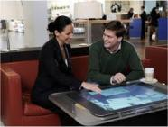
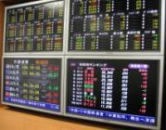
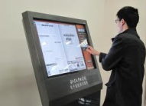
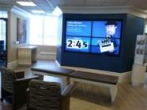
Benefits
Customers
Know better where
invest his money.
Check Financial
Market Infos, rates,
etc.
Quick services for
simple tasks.
Enjoy the time
waiting

Slide 5
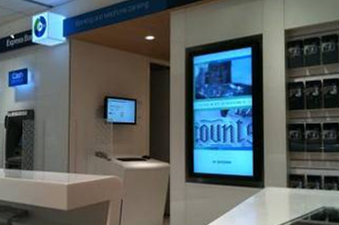
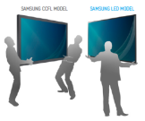
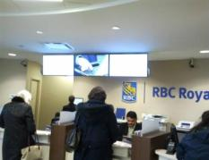
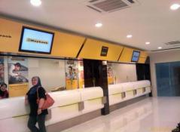
1. Digital Signage Board
Dynamic Contents to increase products offering
Samsung LED Solution
MD and ME series for 16hr
DE series for 24hr
Slim and light
easy installation
maintenance cost saving
[Standard Chartered, Singapoure]
Low power consumption
Low operation cost
Content mgmt on time
Customized per site
[RBC Royal, Canada]
[OCBC, Malaysia]

Slide 6
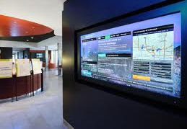
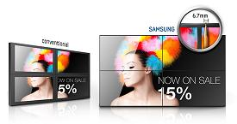
2. Video Wall
Premium sites request a unique design
Samsung Super Narrow Bezel
46”, 55” UD series
B to B : 5.5mm
700 cd/m2
3.7mm(U/L)
1.8mm(R/B)
Narrow bezel
More information with seamless
Convenient calibration tool
Easy adjustable color uniformity
Magicinfo Videowall
Professional digital signage software

Slide 7
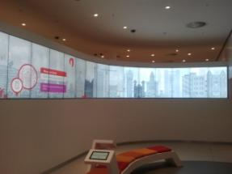
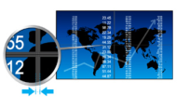
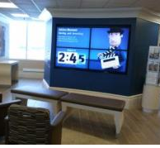
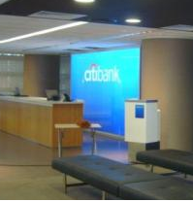
2. Display Wall Information
Premium sites request a unique design
Samsung LED Solution
UE series
Narrow bezel for simple videowall
[ABSA Bank, South Africa]
Bezel to Bezel 10.4mm
Exclusive product for shop large screen
Low power consumption
More Reliability to work until 16 hs day
Slim and light
easy installation
maintenance cost saving
[RBC Bank, Canada]
[Citibank, Hong Kong]

Slide 8
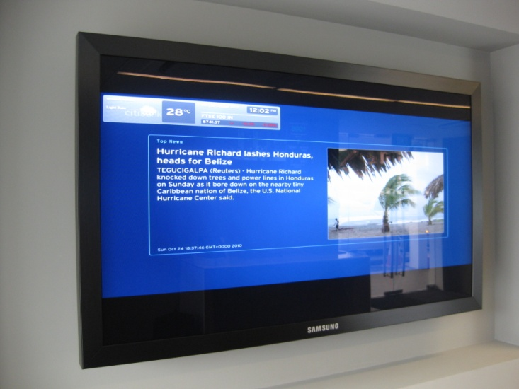
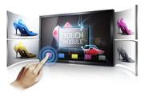
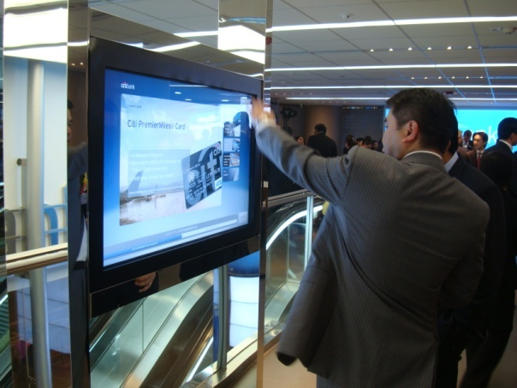
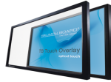
3. Interactive Kiosk
Provide more information with interactive
Samsung Built-in Touch Display
TS series
32”,40”,46”,65”70”
Touch ready to use
Built in touch module
Cost saving without additional device
Slide in PC option
[Citibank, Singapoure
Consulting Terminal]
Touch overlay accessory
ME series (32”, 40”, 46”, 55”, 65”, 75”)
Attachable structure on LED display
6 simultaneous multipoints (32” ~ 55”)
(*2 simultaneous multipoints 65” and 75”)
[Citibank, Singapoure
Information Terminal]

Slide 9
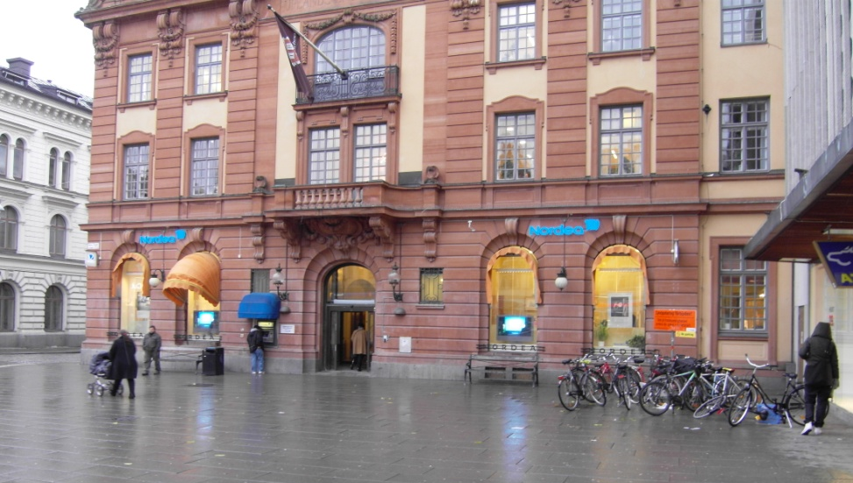
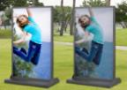
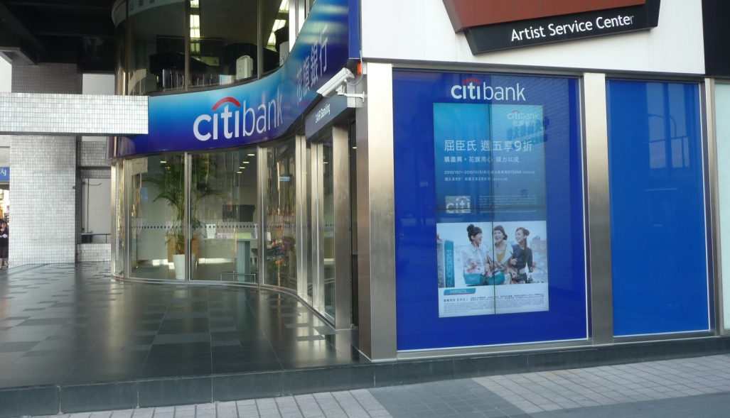
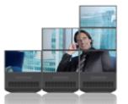
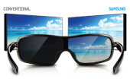
4. Outdoor Solution
Use your wall to sponsor all portfolio through various contents
Samsung Outdoor Solution
46” SL series
Window videowall
1500cd/m2
11mm
High brightness
Increase readability even under direct sunlight
[Nordea Bank, Denmark]
MID options
Release concern about mounting near to shop window
Sunglasses free
Special treatment on surface of panel
[Citibank, Taiwan]

Slide 10
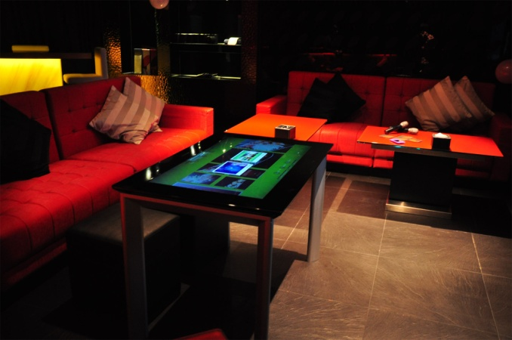
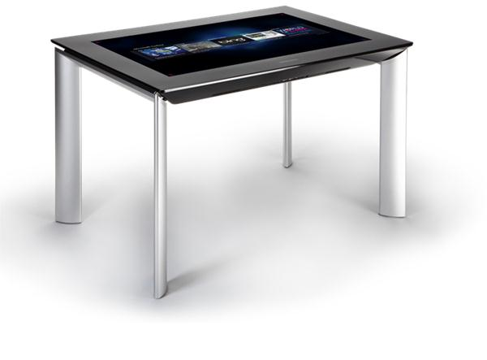
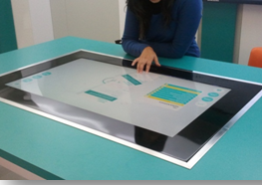
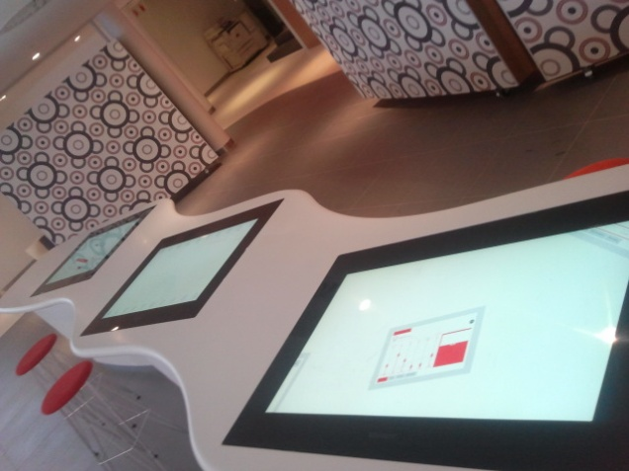
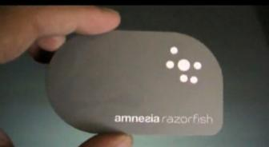
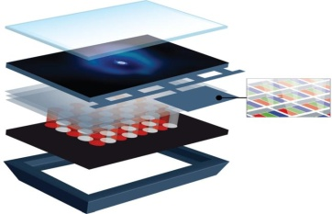
5. Surface
Provide a new experience for customers in your branch
Samsung SUR40 Solution
40” SUR40
Max.52 multi touch
Object recognition
50 points of contact simultaneously
Interact with people
[Red MR KTV, Hong Kong]
Optical tag recognition
Exclusive PixelSense™ technology
Integrated Sensors and IR LEDs
[First National Bank, South Africa]
[ABSA Bank, South Africa]

Slide 11
Value of Samsung LFD
1. Magic Info Software
2. LED Solution
3. Window display Solution

Slide 12
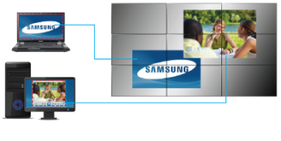
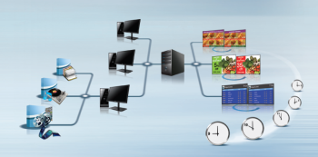
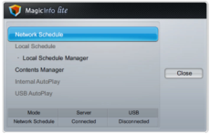
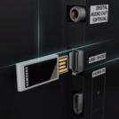
Magicinfo software solutions
Videowall2
Videowall2
Up to 250 video wall display
Compile and edit scenes instantly
Irregular type video wall
Real time data & content management
Creative authoring tool
Mobile server control
Simple and intuitive user interface
Local scheduling on OSD
USB auto play

Slide 13
Value of LED Solution

Slide 14
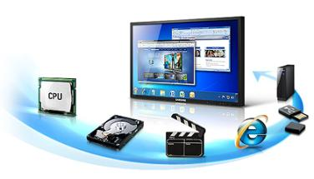
Embedded media player (1/2)
MD series
UE series
DE series
ME series
Internal CPU, memory and storage inside
Conventional display
+ PC
+ S/W
100
25% cost down
Samsung LED display
75
Optimized Light usage operating system based Samsung SOC
Notes:
내장형 미디어 플레이
삼성 LED 제품을 구입했다면, PC를 구입했다고 할 수 있습니다.
내장형 미디어 플레이어와 운영 S/W로 약 25%의 비용을 절감할 수 있습니다.

Slide 15
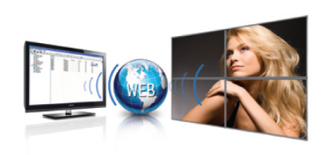
Embedded media player (2/2)
MD series
UE series
DE series
ME series
Player & S/W inside in Samsung LED display
Without any additional device
. Media contents playing supported
Magicinfo Lite S/W
. Provide digital signage user experience
Image
Notes:
추가적인 장비나 PC 없이 비디오, 플레쉬, PPT, 이미지 파일을 재생할 수가 있으며,
로컬이나 서버를 통해 운영이 가능한 S/W를 제공합니다.

Slide 16
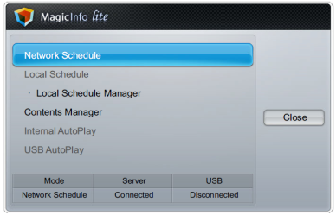
Local controlling
MD series
UE series
DE series
ME series
Simple and intuitive UI only with remote controller
Local S/W management require only remote controller
Also easily copy media contents from external USB memory
Notes:
삼성 LED가 제공하는 운영 S/W인 magicinfo lite의 UI는 단순하고 직관적입니다.

Slide 17
Slim depth
UE series
DE series
ME series
Save about 40% construction cost
Construction
cost
40%
[Conventional]
[LED]
 | Conventional (CCFL) | LED
Construction | Dug-in | none
Labor cost | High | Low
Building remodeling | Yes | No
Wall mount | Strong enough for display weight | Wire type
[Conventional]
[LED]
*Based on Samsung internal data
Notes:
삼성 LED 제품은 제품 두께가 29.9mm 로 얇기 때문에 설치시 공사비가 적게 듭니다.
기존 제품은 제품 두께로 인해 벽파기 공사를 해야 했지만 삼성LED 제품은 필요가 없습니다.

Slide 18
Light weight
UE series
DE series
ME series
Reduce cost on installation and maintenance
32%
cost
Conventional
22.8 kg
460MX-3 model
LED
12.5 kg
ME46B model
[Conventional]
[LED]
Only 60% weight to conventional
Up to 32% manpower cost saving for installation & maintenance
Model | Conventional | LED
Manpower | 2.5 people | 2 people
Average time (h) | 0.4 | 0.2
Cost for 1 unit*** | $20 | $8
Cost for 100 units | $2,000 | $800
Maintenance | Conventional | LED
Manpower | 2 people | 1 person
Average time (h) | 0.2 | 0.2
3 years operation (h)** | 1.2 | 1.2
Cost for 1 unit*** | $48 | $24
Cost for 100 units | $4,800 | $2,400
*Based on Samsung internal data
**Assume every 6 months maintenance conducted
***Assume manpower cost per 1 hour be $20
Notes:
삼성LED 제품은 가볍기 때문에 설치 및 유지관리 비용이 절감됩니다.
비용 계산
- 가정 : 1인당 20달러 인건비, 6개월에 한번씩 보수

Slide 19
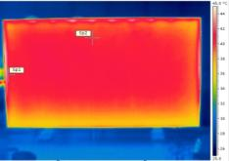
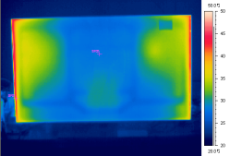
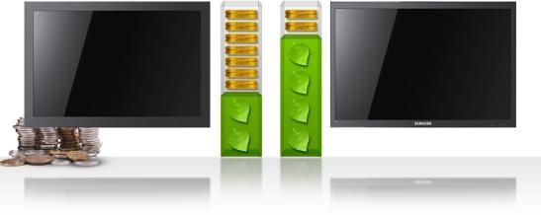
Eco-friendly LED (1/2)
MD series
UE series
DE series
ME series
Reduce half of electricity cost
Conventional
290 watts
LED
160 watts
Model | TV CCFL 46” | LFD ME46A
Power consumption ( 1 unit) | 290 Wh | 160 Wh
Power consumption (16units 4x4 ) | 4,640 Wh | 2,560 Wh
Power consumption for 1 day (16 hour operation) | 74 KW | 41 KW
Power consumption for 1 year | 27 MW | 15 MW
Electricity cost per 3 years | $ 8,667 | $ 4,494
*Based on Samsung internal data
***Assume manpower cost per 1 hour be $20
Notes:
발열량이 적기 때문에 전기료를 절반으로 절감할 수 있습니다.

Slide 20
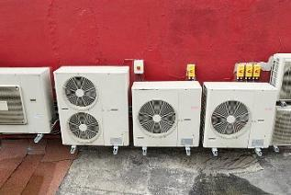
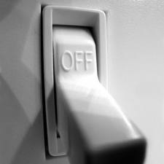
Eco-friendly LED (2/2)
MD series
UE series
DE series
ME series
Less air conditioning cost & thermal restriction
7% more power needed for cooling down 1°C
MS retail store save about $10k electricity cost per a month after changing to UE
Model | Conventional | LED
Power consumption (Wh) | 290 | 160
Heat generation (BTU*) | 988 | 545.6
* BTU : the amount of energy needed for heat up 1°F for 1 pound of water
Notes:
또한 발열량이 적기때문에 제품이 설치된 방에 룸 에어컨디셔닝 비용을 절감할 수 있습니다.
통계에 따르면 1도를 낮추는 데 약 7%의 전력이 더 필요함

Slide 21
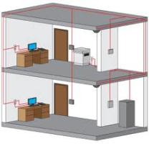
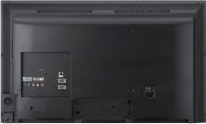
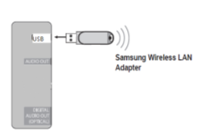
Wireless communication
MD series
UE series
DE series
ME series
Wireless connection supported with dongle
Concept
Biz. Benefit
Wireless dongle from Samsung
. Model name : WIS09ABGN
Construction work needed in ceiling or wall for wired connection
80% Less installation cost*
Installation | Wired | Wireless
LAN cable (10m) | $10 | 0
Repeater (1 to 1) | $40 | 0
Switch (24port) | $70 | 0
AP (300Mb/sec) | 0 | $40
Construction work Per 1 line including labor | $200 | 0
Cost per 1 unit | $320 | $40
[USB terminal on the rear side]
*Detail cost need to be calculated for each case
Notes:
고객의 편의를 위해 무선 동굴을 이용한 원격 제어 기능도 지원합니다.
특히 유선 LAN 공사가 필요한 건물에서는 이 기능을 사용하면 설치 비용을 크게 절감할 수 있습니다.

